Slide 1
Title and Closing Supplier Scorecard

Slide 2
Objective
Provide suppliers team and senior real estate management a functional scorecard to evaluate supplier performance for the title and closing processes
Provide title and closing suppliers a functional scorecard that displays their performance

Slide 3
Report and Data Source
CPM Portal
FM Connect
The scorecard is reported on monthly basis for the selected months and a daily basis for the month-to-date
Fannie Mae (FMN) Equator ODS and POWEBCLM (CDM) databases

Slide 5
Validation
Compared each scoring metric with the Excel based scorecard at asset/issue level
Compared each scoring metric with the Vendor scorecard at asset/issue level
Compared title score and components, closing score and components with the vendor scorecard at aggregate level
Independent code was written and executed to validate the scoring

Slide 6
Contents
Cover Page
Scorecard Summary
Performance Summary
Historical Trend - Title
Historical Trend - Closing
Details - Title
Details - Closing
Glossary

Slide 7
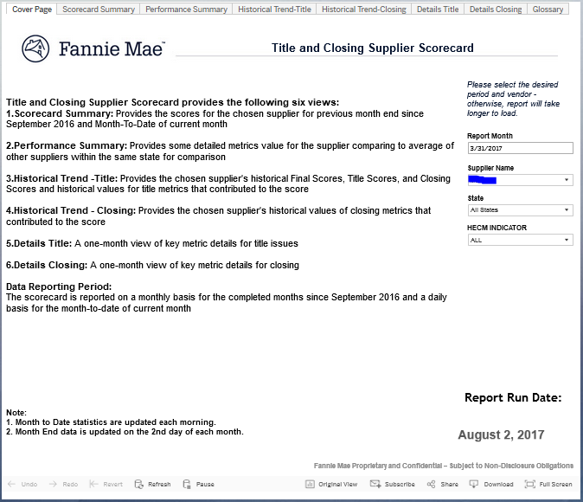
Cover Page
Introduction page for the Title and Closing Supplier Scorecard with descriptions for all the pages in the report

Slide 8
Scorecard Summary & Performance Summary
These two worksheets together provide the daily month-to-date and month-end score for the chosen supplier and the detailed metrics for the supplier firm and other supplier

Slide 9
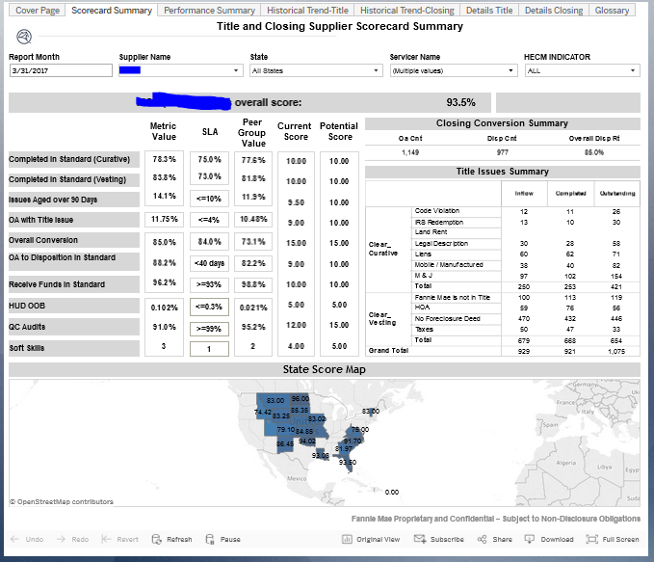

Slide 10
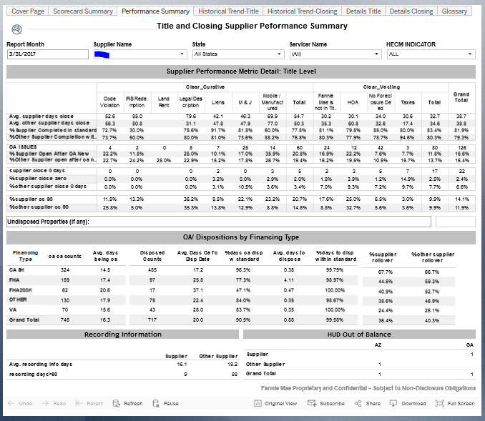

Slide 11
Historical Trend - Title
Provides the month-to-date and prior months historical scores for the chosen supplier including the historical values for title score, closing score and final score, as well as title performance metrics including
Average Days to Completion (Curative & Vesting), % Completed Within Standard (Curative & Vesting), % of Issues Aged Over 90 Days and % Issues Opened After OA

Slide 12
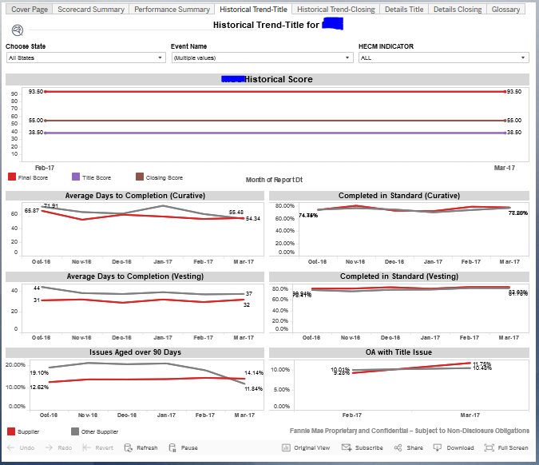
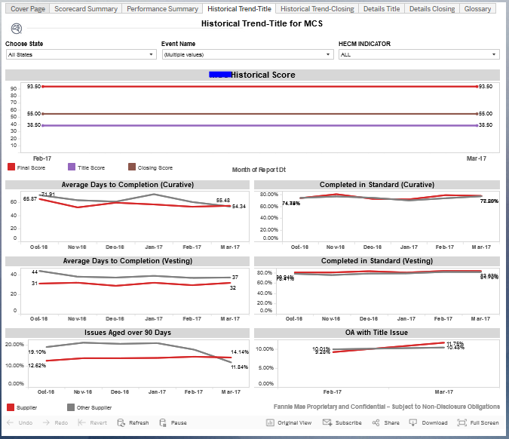

Slide 13
Historical Trend - Closing
Provides the month-to-date and prior months historical scores for the chosen supplier including the historical values for closing performance metrics
Overall Conversion Rate Historical Trend, Days OA to Dispose Trend, Days to Receive Funds Trend, and Days to Dispose Trend, HUD OOB, QC Audit and Soft skill

Slide 14
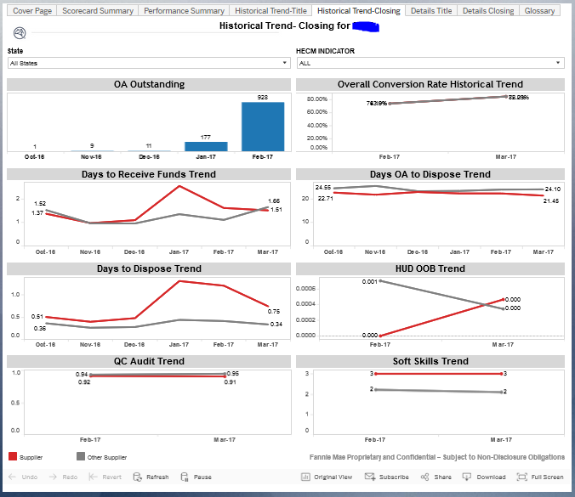

Slide 15
Details - Title
Provides selected property level details for the month-to-date or selected months for the chosen state including
Issues Completed Outside Standard, Issues Completed Within Standard, Issues Outstanding, Issues Opened After OA

Slide 16
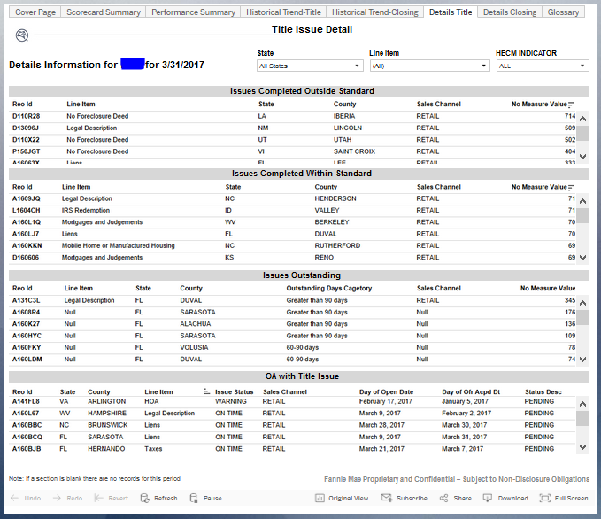

Slide 17
Detail - Closing
Provides selected property level details for the month-to-date or selected month for the chosen supplier and state, including
Properties with Offer Accepted > 40 Days, Properties Disposed Outside Standard, and Funds Received Outside Standard, and HUD OOB

Slide 18
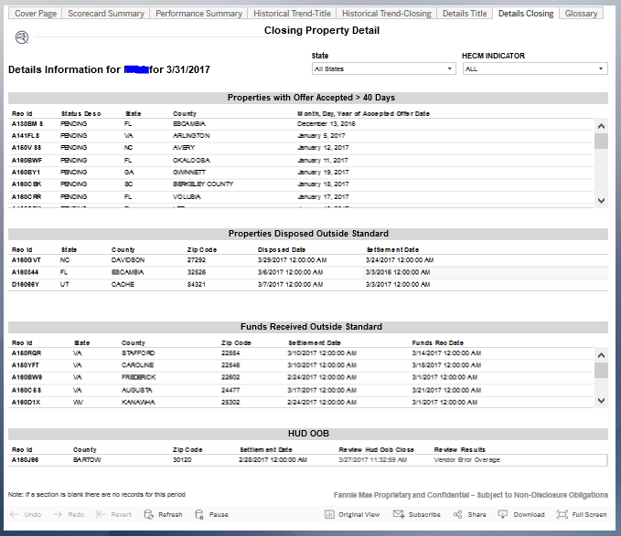

Slide 19
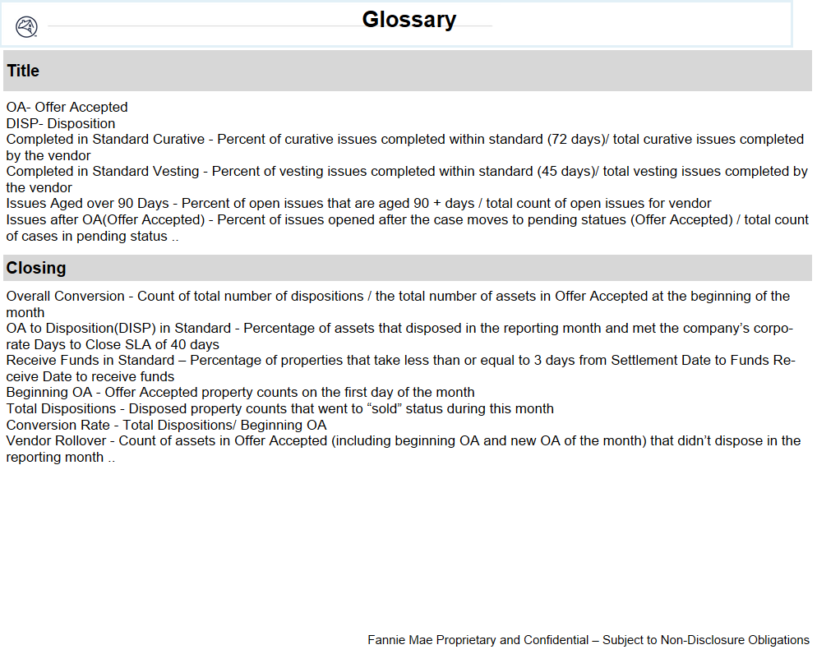
Glossary
Provides a list of terms and definitions

